Slide 1
Sequence Alignment

Slide 2
Outline
What is Sequence Alignment?
Sequence alignment in molecular informatics
Types of sequence alignment
Conclusion

Slide 3
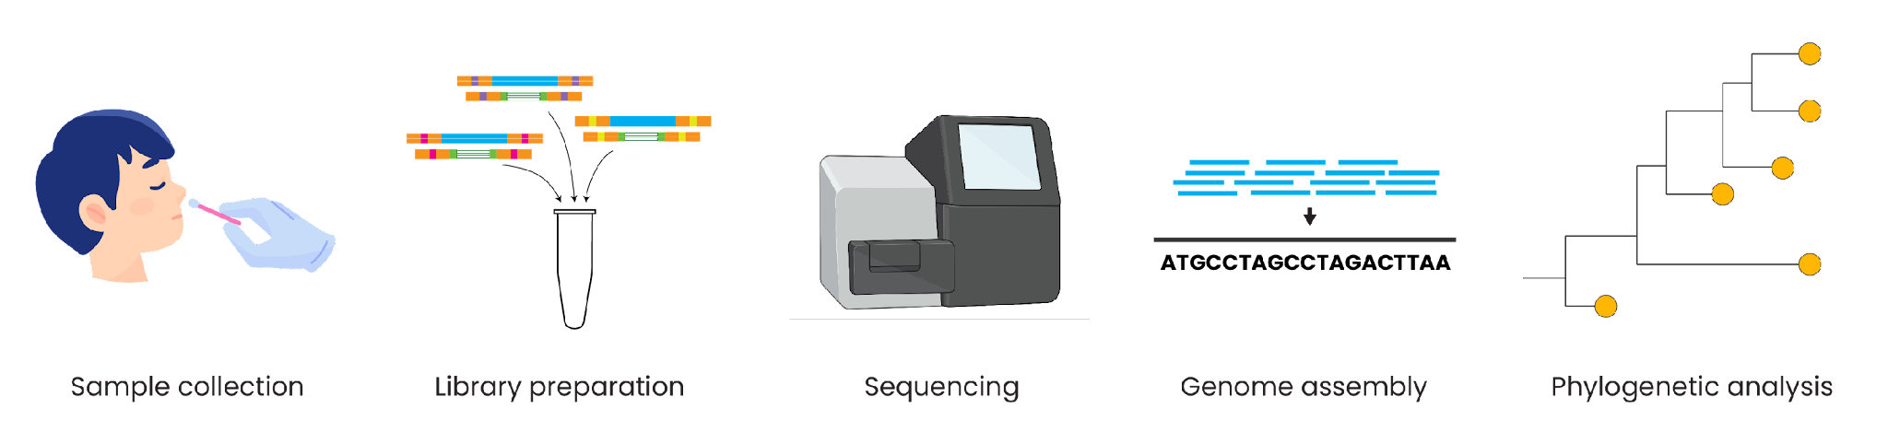
Genomic epidemiology workflow
1
Build a background dataset
Multiple sequence alignment
Run phylogenetic analysis
2
3
BioRender.com
Pixel True https://www.pixeltrue.com/about, CC BY-SA 4.0, via Wikimedia Commons

Slide 4
What is Sequence Alignment?
A field of research focused on development and application of tools for comparing and finding similar sequences in DNA/Proteins.
Infer sequence homology.
Classify genes and proteins

Slide 5
The overarching goal is to bring identical residues in line with each other:
Before alignment
AFGIVHKLIVS
AFGIHKIVS
After alignment
AFGIVHKLIVS
AFGI -HK-IVS

Slide 6
Sequence alignment in molecular informatics
Predict biological function, 2ºry and 3ºry protein structures.
Detect point mutations.
Model molecular evolutionary origin/history of pathogens (lassa, EBV, E.coli) – by Constructing phylogenetic trees.
Given a new sequence, infer its function based on similarity to another sequence.

Slide 7
Find important molecular regions – conserved across species.
Determine the evolutionary constraints at work.
Find mutations in a population or family of genes.
Find similar looking sequence in a database.

Slide 8
SEQUENCING
SEQUENCE ALIGNMENT
Metagenomics
SNP/Variant Discovery
Classify genes/proteins
Phylogenetics

Slide 9
Types of Sequence Alignment
Pairwise Alignment
Multiple Sequence Alignment

Slide 10
Pairwise Alignment
Homology assessment of 2 sequences- DNA or AAs.
Finding the global and local optimum alignment of two sequences.
Similarity score assigned based of differences between the 2 sequences.

Slide 11
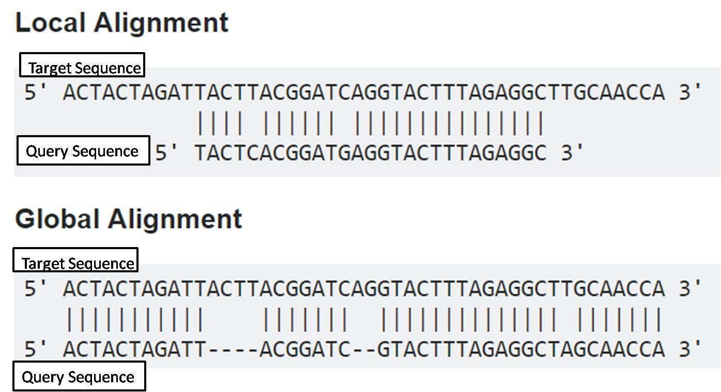
Global vs Local Alignment

Slide 12
Multiple Sequence Alignment
Find similarities between many sequences
Based on Heuristic algorithms
e.g. ClustalW, ClustalX, Clust Omega, Muscle, MAFFT, T-coffee.

Slide 13


Types of multiple sequence alignment
Alignment with a reference genome
Alignment without a reference genome

Slide 14
Types of multiple sequence alignment
Alignment with a reference genome
Faster and less computationally intensive
Ensures consistent coordinates
Alignment without a reference genome

Slide 15
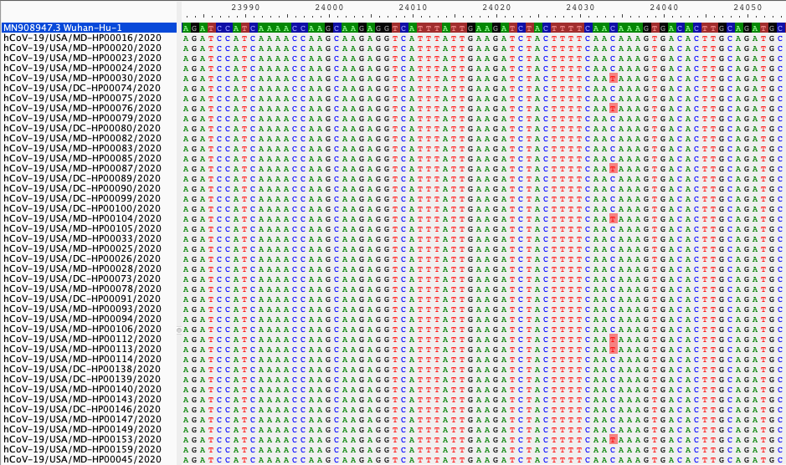
Alignment with a reference genome
Position along reference genome
Reference
genome
Your assembled FASTA files, aligned to the reference
Single nucleotide variants, compared to reference
Aligning to a reference genome gives us a baseline to call variants against

Slide 16
Selecting an appropriate reference genome
Ways to choose a reference genome:
If possible, use the same reference genome as others working on the same outbreak
  e.g., Wuhan-Hu-1 for SARS-CoV-2
  e.g., Makona-Kissidougou-C15 for Ebola virus
Use the earliest sequence from the outbreak, if available.
Use a sequence from a prior outbreak in the same location.
Search NCBI RefSeq (https://www.ncbi.nlm.nih.gov/refseq/) for an established reference
The reference genome should always have a date before the earliest of your samples

Slide 17
Summary
Multiple sequence alignment is required prior to phylogenetic analysis.
Alignment with a reference genome is faster and often preferred over reference-free alignment.
Always inspect your alignment to ensure quality.

